Slide 1
Sum of Subset Problem

Slide 2
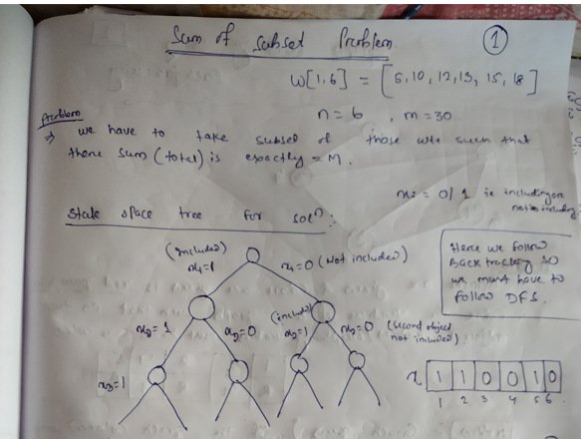

Slide 3
